Slide 1
Physical, Mental, & Emotional
Balance for Learning and Health
Bob Van Oosterhout, MA, LLP, LMSW
Lansing Community College
Center for Teaching Excellence
April 4, 2017

Slide 2
Common Myths
Myth
Evidence
Hard work and long hours pay off
Stress can be good for us
We work better under pressure
High Stress is a sign of commitment and motivation
“Employee output falls sharply after a 50-hour work-week, and falls off a cliff after 55 hours” Long hours result in significant increase in accidents and health problems
Stress builds tension which interferes with functioning
US Army study : trained technicians took 2-3x longer when thought under attack
High stress is a sign of diminished capacity and increased likelihood of mistakes

Slide 3
Effects of Being Out of Balance
Escalating Physical, Mental, Emotional tension
Narrow vision, limited receptivity and learning
Pressure, hurry, Increased reactivity
More errors, less efficiency, limited creativity
Short-term focus, easily distracted, procrastination
Return to old methods, Increased rigidity
Diminished awareness (tend not to be aware of reduced effectiveness)
More self-centered, less empathic, need control
Diminished capacity for recovery

Slide 4
Research on Overwork
Each additional patient assigned nurses resulted in 7% increase in 30-day patient mortality
When nurses had eight patients instead of four, their patients had a 31% higher chance of dying within 30 days of admission
The risk of occupational injury is doubled when employees work more than 12 hours per day and goes up by over 40 per cent over 10 hours in a given day
worker performance in a sample of white-collar jobs decreased by as much as 20 per cent when 60 or more hours were worked per week

Slide 5
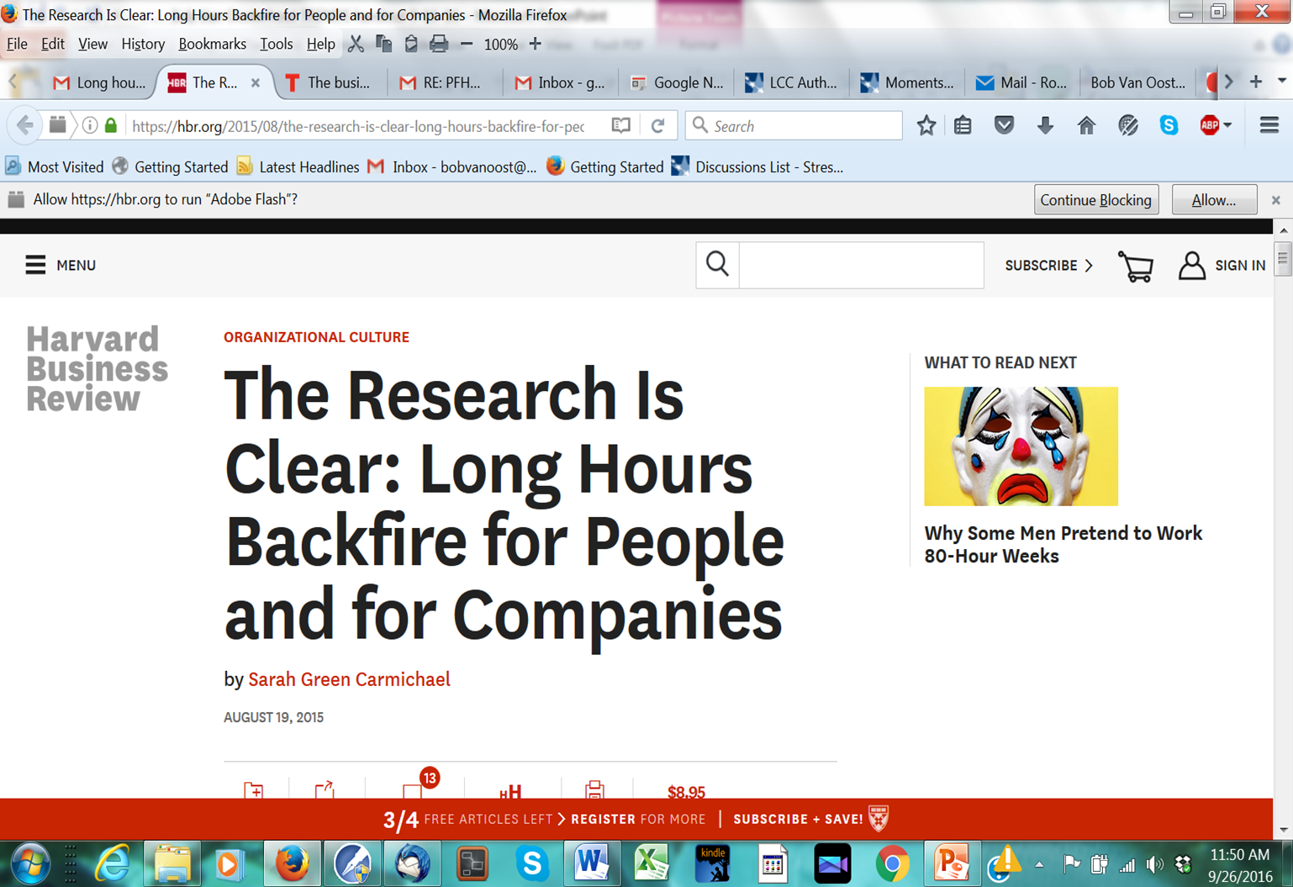
“…overwork is literally a story of diminishing returns: keep overworking, and you’ll progressively work more stupidly on tasks that are increasingly meaningless.”

Slide 6
Causes of Imbalance
Lack of sleep (<7-8 hours on regular basis)
Overwork, lack of effective support
Exhaustion, insufficient recovery time
Stress, pressure, hurry
Pushing, driving, trying too hard
Unrealistic expectations, perceptual disconnect
Limited variety and contrast in activities (social/alone, active/quiet, work/recreation, etc.)
Conceptual and Structural Emotion
Lack of purpose or meaning

Slide 7
How it Works: Interaction of Body, Mind and Emotion
Body produces energy for activity and maintenance, sends information to the mind, experiences emotion, creates signals when there is a need for balance
Mind responds to perception and experience, maintains the capacity for assessment, reflection, discovery, and creativity, send signals to body to carry out action. (Mind includes perception and thought)
Emotion responds to perception, physical state, and thought and maintains the capacity for empathy

Slide 8
How It Works: Body
Autonomic nervous system regulates the production and distribution of energy.
Either sends energy to muscles for movement (sympathetic) or to internal systems for maintenance (parasympathetic)
Responds to input from thought, perception, and proprioception
Balance is maintained by responding to signals regarding need for rest, food, activity etc.

Slide 9
How It Works: Thought
Brain is continually forming, creating neural pathways and adapting to perception, thought, and experience. --road analogy
Pathways used regularly are most easily accessed
We are either creating new pathways or reinforcing old ones
We have the capacity to choose our focus and to assess, discover, value, and make choices about action and direction in the short or long term as appropriate to the situation

Slide 10
How it Works: Perception
(Analogy from Photography)
Frame – Conceptual habits, beliefs & attitude limit what we see.
Filter – Emotional state & mood limit how we see.
Focus – What we pay attention to determines our priorities
Understanding another’s Frame, Filter, and Focus requires Balance & facilitates healthy relationships and effective problem solving.
Perceptual habits/restrictions limit our view of reality

Slide 11
How it Works:
Emotion
The function of emotion is to provide a quick assessment of the current situation, to help us connect with other people & fit our actions with the needs of the moment.
All humans (and many animals) share the capacity to experience the same emotions
Emotions are physical experiences that are temporary unless continually stimulated.
The full experience of emotion is blocked by tensing and breath holding

Slide 12
How it Works: Emotion (cont.)
There are four kinds of emotion
  Natural emotion – response to perception of the moment
  Mental emotion – response to thought
  Structural emotion (Tension) – build-up of physical tension formed in response to trauma or through habits of resisting emotion
  Attitude/Motivation – develops in response to beliefs/values and emotional habits
  Conceptual and structural emotion stimulate the build-up of mental and physical tension

Slide 13
What Goes Wrong:
Inappropriate Shift to Crisis Mode
Body interprets input from mind or increasing tension as a threat, activates sympathetic nervous system, shifts all resources to muscles for fight/flight , suppresses functions not related to immediate survival
Perception narrows, become fixed and darkened
Thoughts pulled to focus on potential threats and to what worked before. Learning, problem solving are restricted, create wide/broad categories (either/or)
Emotions become numb and/or reactive. Conceptual emotion maintains/escalates crisis mode

Slide 14
Effects of Crisis Mode
Each area of tension feeds the other creating a self-escalating process between body, perception, thought, and emotion that continually stimulates the sympathetic nervous system
The release of stress hormones sustains this process
Increasing tension diminishes awareness of the effects of crisis mode and decreases the likelihood of restoring balance.

Slide 15
What Goes Wrong: Body
Overstimulation of sympathetic nervous system continually builds tension.
Increasing patterns of tension pull thoughts to continually stimulate crisis mode
Feel exhausted yet hurried and driven
Parasympathetic nervous system is suppressed, which restricts health maintenance, rest, and recovery
(Increased energy and focus from fight-or-flight only benefits if there is no previous build-up of tension. It dissipates in minutes.)

Slide 16
What Goes Wrong: Perception
Frame shrinks and becomes rigid
Filter clouds and/or darkens
Focus becomes fixed and/or scattered
Tendency toward
  Blame, judgment, need for control
  Fear, defensiveness
  Self-centeredness
  Despair, negativity

Slide 17
What Goes Wrong: Thought
Build-up of tension draws focus to “What’s wrong?”
Thinking is pressured, simplistic, short-term
Create broad categories , all or nothing
Reduced receptivity, learning and memory
Priorities blur – everything appears critical
Content of thought becomes increasingly narrow, negative, rigid, scattered, drawn to old solutions
Negative thinking/recycling builds more tension

Slide 18
What Goes Wrong: Emotion
Full experience of emotion is blocked by muscle tension and breath holding
Emotions become reactive (“sunburn response”) and/or numb
Decreasing sensitivity, empathy and frustration tolerance
Stimulates Conceptual Emotion
Triggers and feeds Structural Emotion

Slide 19
What Works: Start by Restoring Physical Balance
The body is the storehouse for tension. Escalating tension restricts perception, thought and emotion
Stopping the build up of tension and allows personal resources to come back online.
Reducing physical tension opens up perception and makes it much easier to be aware of and choose what we think about.
Since tension blocks the full experience of emotion reducing physical tension is necessary to resolve emotional tension.

Slide 20
What Works: Body
Restore long-term balance to autonomic nervous system by activating the parasympathetic nervous system through regular practice (6-10 x daily for 2-6 weeks) of Natural Rhythmic Breathing
Become aware of and resolve patterns of tension through regular practice of Grounding (2-5 X daily)
Three Videos:
Natural Rhythmic (Diaphragmatic) Breathing
Dealing with Obstacles to Natural Rhythmic Breathing Grounding
http://bobvanoosterhout.com/id133.html

Slide 21
What Works: Thought
Develop the capacity to redirect thought by creating an established mental pathway through regular repetition (100s x daily) of a Rhythm Phrase. (Thought Refocusing)
Develop the capacity to be aware of and the ability to redirect thought through regular meditation
Develop a habit of clarifying the direction and appropriateness of current thinking
Three Videos:
Clearing your Mind,
Meditation,
How to Stop Worrying
http://bobvanoosterhout.com/id133.html

Slide 22
What Works: Emotion
Avoid tensing and breath holding during emotional times to allow the full, momentary experience of emotion
Shift perceptions and redirect thinking when response to emotions builds tension or interferes with the task at hand
Separate thought from emotion to prevent emotional recycling and when responding to structural emotion or memories from the past
Four Videos
Understanding Emotion, PTSD, Depression, Dealing with Loss http://bobvanoosterhout.com/id133.html

Slide 23
What Works: Perception
Be aware of how our own and other’s frames, filters and focus limit perception, understanding, and empathy
Develop perceptual flexibility and understanding by developing the ability and inclination to view situations through the frames, filters, focus of others.
Incorporate “Components of Clear Perception” into perspective

Slide 24
Components of Clear Perception
Compassion
Personal Responsibility
Hope
Humility

Slide 25
Compassion recognizes the dignity and potential of each person. It involves looking at life from another person’s perspective without judgment while understanding how circumstances contributed to forming his or her behavior, attitude, and outlook. True Compassion requires the capacity to briefly experience the emotions and perspective of another. Compassion allows other people to be fully themselves in our presence. It connects, includes, and opens. Compassion is not simply a concept; it is something we experienced together. We are touched by compassion and it allows us to touch and be in touch with others.

Slide 26
Personal Responsibility recognizes that each person (especially oneself) has unique gifts and potential along with the ability to respond and contribute. Personal Responsibility involves finding balance between the needs of a situation and the capabilities and limitations of participants. Personal Responsibility rejects the authoritarian term “should” and avoids blame, guilt, and resentment. It simply looks at what each participant (particularly oneself) can realistically do to improve work, relationships, organizations, and communities.

Slide 27
Hope realizes that there is an effective way to handle each situation and that every experience presents a learning opportunity.
Hope believes that each one of us has an inborn capacity to improve our lives and world.
Hope resides in our hearts and in our souls.

Slide 28
Humility involves recognizing our inter-dependence and inter-connectedness along with the effects of our actions on others.
Humility allows us to see ourselves as part of a greater whole, to realize that we have a significant, but limited role, and to explore how and where we best fit in contributing to and improving our world.
Humility recognizes that placing ourselves above or below another person diminishes us both.

Slide 29
What Health Looks Like:
Components of Balance
Physical
Autonomic nervous system balance
Parasympathetic is regularly activated
Not building muscle tension
Adequate capacity for recovery
Sufficient sleep
Proper nutrition
Balance between types of activity, rest/activity etc.
Emotional
Able to allow full experience of emotion without tension or breath-holding
Able to separate emotion from thought to avoid emotional recycling
Able to briefly experience other’s emotions
Natural empathy and compassion

Slide 30
What Health Looks Like:
Components of Balance
Thought
Recognize direction and likely effects of thought
Able to redirect and clarify thinking when not helpful or productive
Thought becomes integrated with experience
Regular time for reflection and discovery
Perception
Flexible frame
Clear, receptive filter
Adaptable Focus
Components of Clear Perception
  Compassion
  Personal Responsibility
  Hope
  Humility

Slide 31
Everything* is easier to the extent we are in Balance and more difficult to the extent we are out of Balance.
*Except anxiety, anger, mistakes, misunderstanding, panic attacks, heart attacks, depression, conflict, psychosis, procrastination**, etc.
(**Procrastination is a guilt-ridden attempt to restore Balance)

Slide 32
Balance Is A Choice
When we make balance a high priority, we can more effectively prioritize and manage demands and potential stressors.
This brings a sense of ease as well as quality and effectiveness to work and relationships.

Slide 33
Additional Information
Videos on Balance Techniques and topics related to this presentation can be viewed at:
http://bobvanoosterhout.com/id133.html
Additional articles, information and presentation screens and handouts can be viewed at www.bobvanoosterhout.com
Email Bob:
bobvanoost@gmail.com

Slide 34
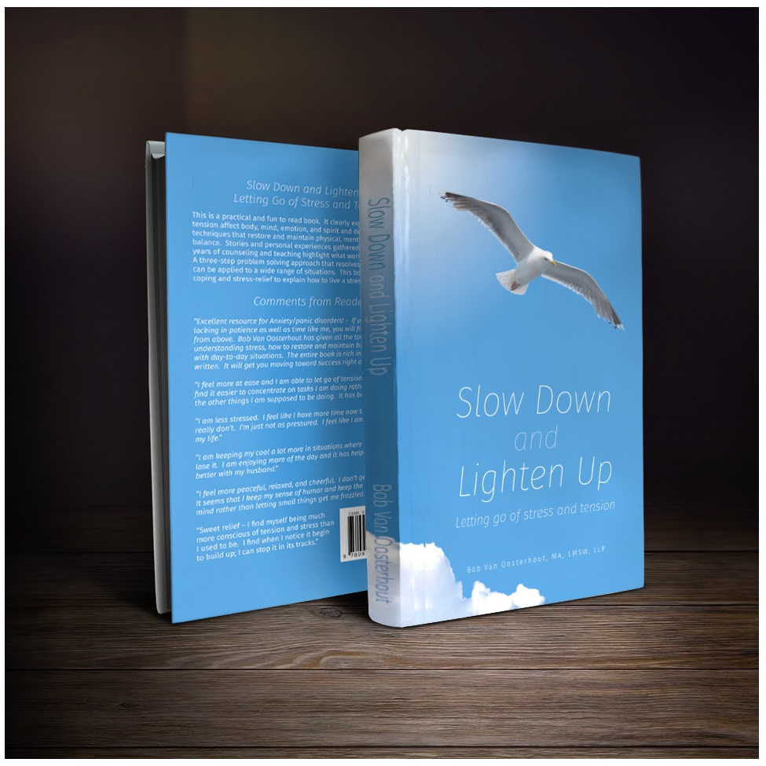
Van Oosterhout, Bob, Slow Down and Lighten Up: Letting Go of Stress and Tension, 2016
Available through Amazon.com, Kindle and select bookstores

Slide 35
LCC Course
PFHW 181
Stress Management
(Online)
(Note: On-campus and 8 week online sections are taught by other instructors)

Slide 36
Current project in response to the election and recent political events:
Bring Truth to Fear
(http://bobvanoosterhout.com/id137.html)

